Slide 1
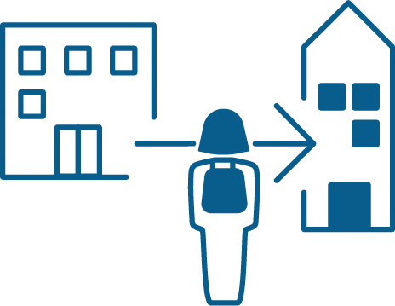
TACKLING TRANSFER
BACKGROUND
If U.S. higher education is to achieve its goals of fostering social mobility and developing talent, transfer is critical, especially for the more than 10.5 million students enrolled nationally in community colleges. But while many advances in transfer practice and policy have been made, one major challenge remains: Incredibly low bachelor’s attainment rates among students who enter community college with the goal of attaining a bachelor’s degree.
The good news is that, over the past two years, the focus on improving transfer results is sharpening. The time is ripe for a concerted effort to scale improvements in student transfer outcomes by adopting a “both/and” approach to practice and policy. It is now time for states to experiment with a comprehensive approach to significantly improving outcomes for baccalaureate-seeking community college students.
Research reveals that up to 80% of entering community college students aim to earn a bachelor’s degree but only 14% do so within six years.
This gulf between aspirations and outcomes is even wider for students of color, first-generation college goers, and low-income students – all populations more likely than others to enter higher education in community colleges, but much less likely to attain a bachelor’s degree.
PROJECT GOALS
In order to address these unfavorable outcomes for transfer students, The Aspen Institute’s College Excellence Program, HCM Strategists, and Sova have established a partnership to tackle these persistent transfer issues across the country. The three lead organizations will partner with institutional leaders, policy makers, and practitioners in three states (Minnesota, Texas, and Virginia) to pave the way for dramatic improvements in transfer outcomes for baccalaureate-seeking students who begin at community colleges.
Building on significant national momentum to improve transfer student outcomes, this effort will take a comprehensive approach that incorporates policy, practice, research, and strategic communications to foster the conditions for scaled and measurable improvements in attainment rates for baccalaureate-seeking community college students, including the large number of low-income students and students of color who begin education in the two-year sector. The three-year implementation phase of this project will pursue the following goals:
Significantly and appreciably improve leading indicators of transfer student success in each of the three states
Build capacity and remove barriers in policy and practice so that transfer reforms take root and outcomes continue to improve significantly beyond the grant period
Generate substantial new, actionable knowledge about what it takes for a state to improve student transfer outcomes
Broadly disseminate knowledge about how to improve transfer outcomes nationally

Slide 2
TACKLING TRANSFER
The Aspen Prize for Community College Excellence
PROJECT OVERVIEW
Each state’s plan will be crafted in collaboration with state leads and tailored to its particular context. Each plan will include:
Goal-setting support. To provide a shared purpose for our work, each state partner will develop quantifiable goals. Among other things, the Tackling Transfer team will provide support in establishing baseline data and analyzing and reporting student outcomes data.
Strategic communications. The Tackling Transfer team will make the case for the importance of transfer to state and national audiences, and support our state partners in doing the same.
Customized institutional support. This will include team workshops, leadership convenings, and targeted technical assistance to elevate best practices from the field.
State/system policy work. This will be integrated with institutional practice efforts. In collaboration with our state partners, the team will assess opportunities and challenges in existing or forthcoming state transfer policy.
Qualitative research. The Tackling Transfer team will collect and provide qualitative research on policies and practices that correlate to high levels of transfer student outcomes. What we learn from the three partner states will be widely shared with the field.
PARTNERS
While Tackling Transfer is managed and led by The Aspen Institute’s College Excellence Program, HCM Strategists, and Sova, the planning and strategy work that happens on the ground in each of our three states is led by our state leads:
MINNESOTA:
Minnesota State
TEXAS:
The Charles A. Dana Center
VIRGINIA:
State Council of Higher Education for Virginia
Virginia’s Community Colleges
SUPPORTERS
Tackling Transfer is made possible through the commitment and support of the following philanthropic partners:
For more information about Tackling Transfer, please contact Program Associate McKenzie Maxson at mckenzie.maxson@aspeninstitute.org.
CONTACT:

